Slide 1
Sophomore College Planning Meeting
Tuesday, April 9, 2024

Slide 2
Review of College and Career Center Curriculum
Ninth Grade
Family Meetings
  1st Trimester and 2nd Trimester
  Choices Made Now Affect Options Later
Survey, Transcript, College Application Overview and Course Planning
  Registration Presentations in History Class

Slide 3
Tenth Grade
College Planning Night/National College Fair
Preliminary Financial Aid Planning Night
Personality Assessment/Career Information
“Strengths Explorer” Assessment and discussion
College and Career Speakers in the CCC
College Fair
April 16 at Holy Angels, 6:30 – 8:00 pm
Tonight’s Sophomore College Planning meeting

Slide 4
Eleventh Grade
College Planning Night – September 23
  Breakout Sessions, Variety of Colleges Represented
  National College Fair, October 22
Practice ACT— September 13 and PSAT - October 16
Financial Aid Night, October 15
Jr. Family Meetings begin in January
Jr. College Day— January 28
  Build a College Portfolio with a transcript designation of complete or incomplete due in April
  Sessions on Essay Writing, Resume Writing, Mock Admission Committee, College Search, Career Speakers, etc.
College Fair

Slide 5
Senior Year
Check In Meetings – What is the plan?
  College Representative Visits
Applications
Scholarships
  Class of 2023 was offered over $16 million dollars in scholarships and they accepted over $4 million to use toward their specific chosen colleges.

Slide 6
What can students do now to prepare for college?
Start researching colleges
Attend the College Fair, Virtual College Events and Presentations advertised in the Daily Bulletin and Parent Newsletter
Prepare for standardized testing (PSAT, ACT or SAT)
Utilize resources in Naviance
Start visiting colleges (if possible)
Attend college meetings and career speakers in the College and Career Center

Slide 7
Researching Colleges
College Fair, April 16
Attend College Planning Night on Monday, September 23
Attend the MN National College Fair October 22 at the Minneapolis Convention Center
Start looking up colleges in Naviance for more information
Follow colleges on social media

Slide 8
Utilize Resources in Naviance
All students have access to their Naviance account and should be using it for:
  College Research
  Finding out about visits in the CCC
  Updating their activity resume
  Looking at their personality profiles and career assessments.

Slide 9
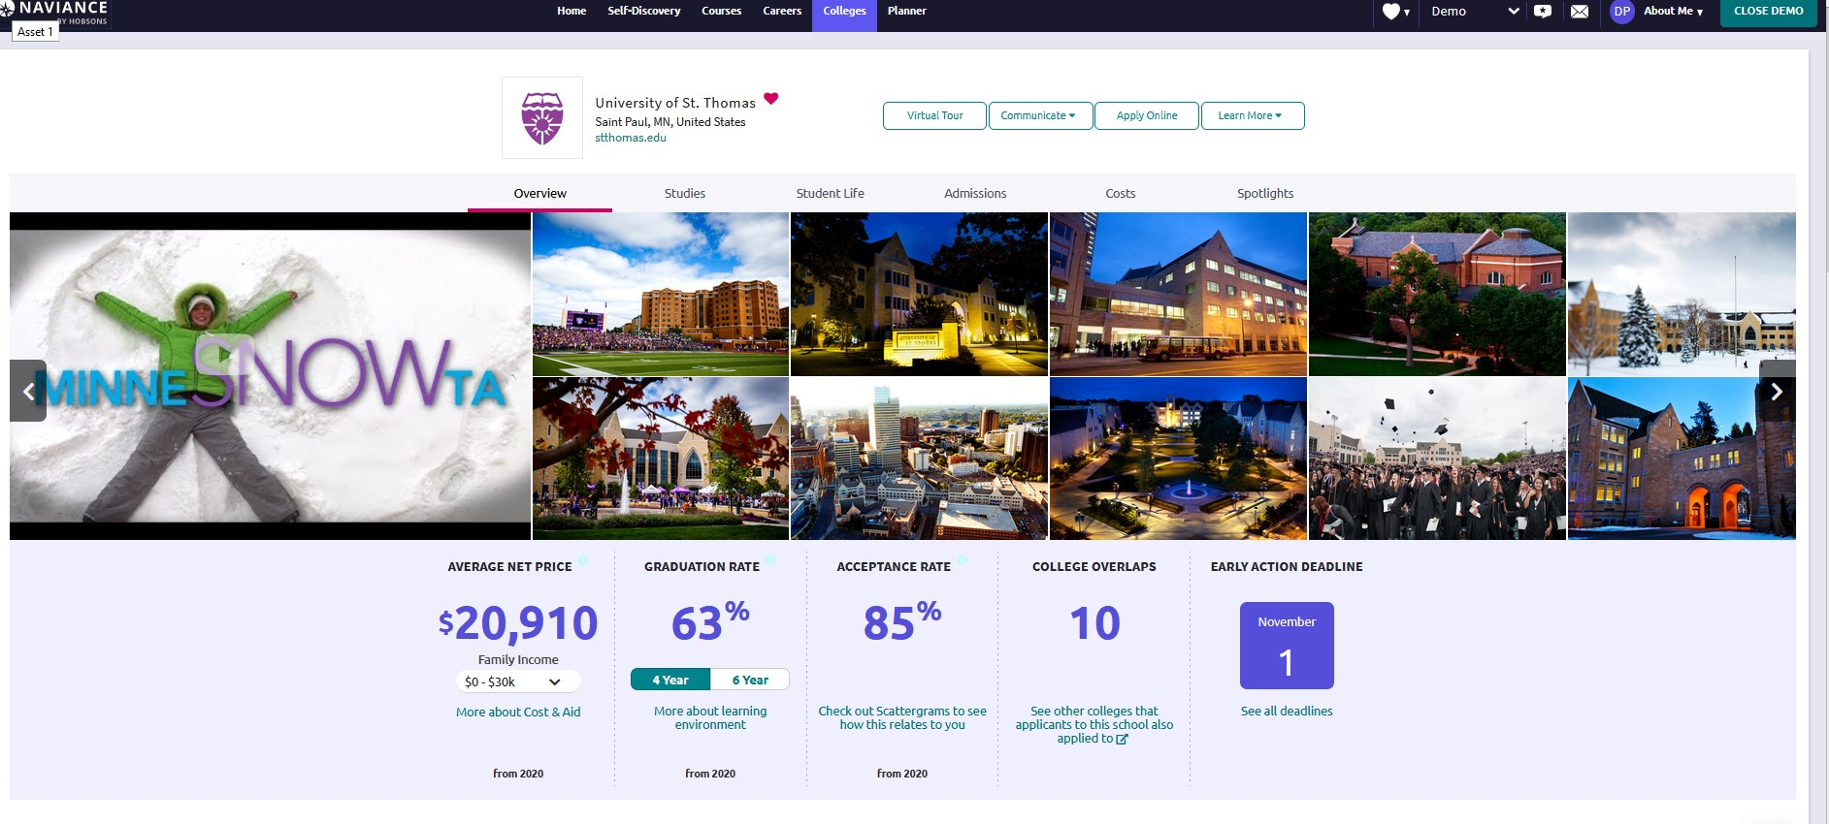
Example of college information in Naviance

Slide 10
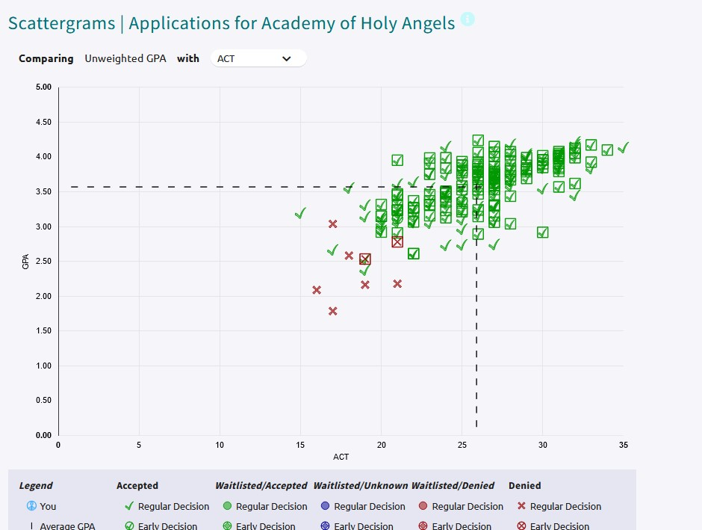
More from Naviance

Slide 11
College Fairs
Whether you are attending a college event virtually or in person, think about:
Researching ahead of time what colleges you might like to see or sessions you would like to attend and use the “Questions to ask” handout.
Registering in advance for the college fair and, if in person, bring your printed registration code to the fair to be scanned by the representative at the table. STRIVEFAIR.COM

Slide 12
Making College Visits
Lots of virtual and in person visit options available. Schedule appointments online or by calling the school AT LEAST 2 WEEKS IN ADVANCE IF POSSIBLE.
Options during visits may be limited, but if possible, you should meet with someone from Admissions and get a campus tour. If you want, ask to sit in on classes or meet with faculty or coaches too.
Don’t overwhelm your student by doing more than 2 visits a day—trust us!
Keep notes on each school after visit.

Slide 13
College Visits and Career Speakers in the CCC
We usually host over 100 colleges and career speakers in the CCC during the school year. The schedule is on the digital boards outside the CCC, in Naviance, and in the Daily Bulletin which is emailed to students every day.
Students must sign up at least 4 hours in advance of the visit to get a pass and have the permission of their teacher to miss class for a presentation in the CCC.

Slide 14
Prepare for PSAT, ACT and SAT
Things are in Flux! Testing requirements are changing all the time.
All families received results of sophomore Pre-ACT in November. Testing is reviewed during the Data Day.
PSAT score as a junior determines National Merit status. The qualifying semifinalist score changes every year.
AHA offers PSAT prep class in the fall
All juniors will take a practice ACT in September

Slide 15
Preparing for ACT and SAT
We recommend juniors sign up for one or two of the three spring ACT tests—February, April or June. This can vary by student. If you have individual questions about your student’s testing plan, please ask us.
For a fee ($40), on the April, June, and September ACT dates students can order their answer sheet and test book to be sent to them after the test. This is called Test Information Release(TIR). See handout.
Students should take the ACT twice but no more than 3 times.
AHA offers ACT prep classes before the April and June ACT dates.
There is a list of ACT prep companies on the AHA website on the College and Career page.
Students can also access Methodize Test Prep through their Naviance account.

Slide 16
ACT and SAT
According to the ACT Profile Report for Minnesota, 68% of 2023 MN HS grads took the ACT — average MN composite score was 20.8 and the National average was 19.5. The AHA average for class of 2023 was 25.2.
Only two students took the SAT in the class of 2023.
Colleges accept either the SAT or the ACT for admission purposes.
The ACT is offered at AHA. The SAT is offered at other schools in the area.

Slide 17
PACC Credit at Holy Angels
Program for Advanced College Credit (PACC) is a program offered by St. Mary’s University in Winona that awards college credit to several advanced and AP classes at AHA.
Students can gain either 3,4 or 6 credits for the courses.
See the handout provided for more information about courses and cost per credit.

Slide 18
Staying on Track
Grades—Students need to be working to the best of their ability.
Course selection—Colleges want to see students are challenging themselves appropriately.
Connections with teachers—Students will need to ask teachers to write recommendations for college in a year—have they built good relationships with teachers to do this?

Slide 19
A few final things…
Working with Independent Counselors
Students—Read the Daily Bulletin
Conversations about paying for college

Slide 20
We are here to help!
Please call or email if you have questions
Ann Kjorstad—Students A-L
612-798-2691
akjorstad@ahastars.org
Tina Proctor—Students M-Z
612-798-2639
tproctor@ahastars.org
Also—we have updates weekly in the Star Connections parent newsletter and you can follow us on our Instagram page @ahacollegeandcareercenter

Slide 21
Questions for Prizes!!!
Who will take the FREE Practice ACT on September 13 during the school day next fall?

Slide 22
Question 2
When will the college counselors start meeting with Juniors?
BONUS Question: Why is this the earliest we can meet with Juniors??

Slide 23
Question 3
Name programs in junior year designed to help students learn more about colleges and the search process.

Slide 24
Question 4
Name 2 ways to find out about college reps visiting or career speakers for students.

Slide 25
Question 5
Where can parents find weekly updates about everything they may need to know about the college search and upcoming programs?

Slide 26
Question 6
Sophomores—What are your 3 strengths and one action item?

